Slide 1
Installing and Using MySQL
COMP306: Database Management Systems

Slide 2
Introduction to MySQL
A well-known RDBMS that uses SQL
The server can communicate with the mysql client or any other program
Today’s focus is installing the MySQL server and interacting with it through the MySQL terminal client and MySQL Workbench
mysql
(MySQL client)
mysqld
(MySQL server)
my_app
(Some other process)

Slide 3
Installing MySQL
Official documentation for installing on various systems:
Windows: https://dev.mysql.com/doc/refman/8.0/en/windows-installation.html
Linux: https://dev.mysql.com/doc/refman/8.0/en/linux-installation.html
(Ubuntu/Debian: https://dev.mysql.com/doc/mysql-apt-repo-quick-guide/en/)
MacOS: https://dev.mysql.com/doc/refman/8.0/en/macos-installation.html

Slide 4
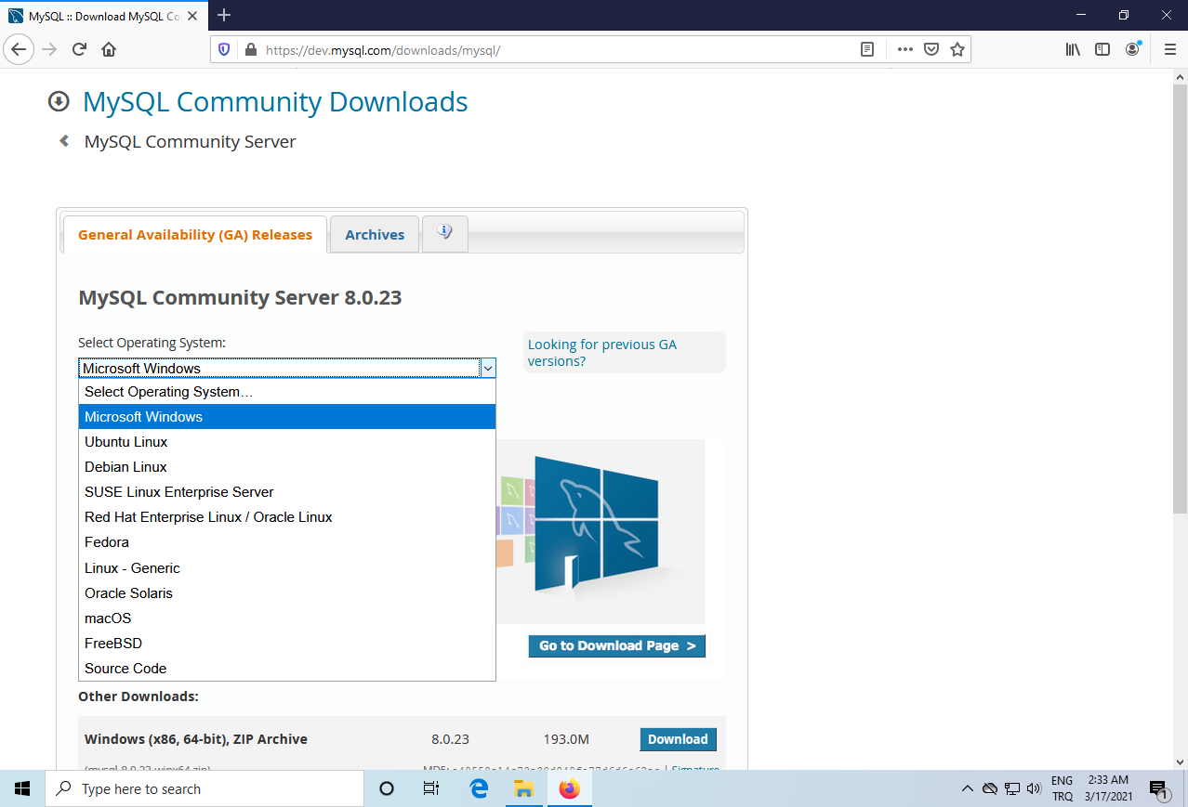
Installing MySQL
Get MySQL Community Server for your operating system from: https://dev.mysql.com/downloads/mysql/

Slide 5
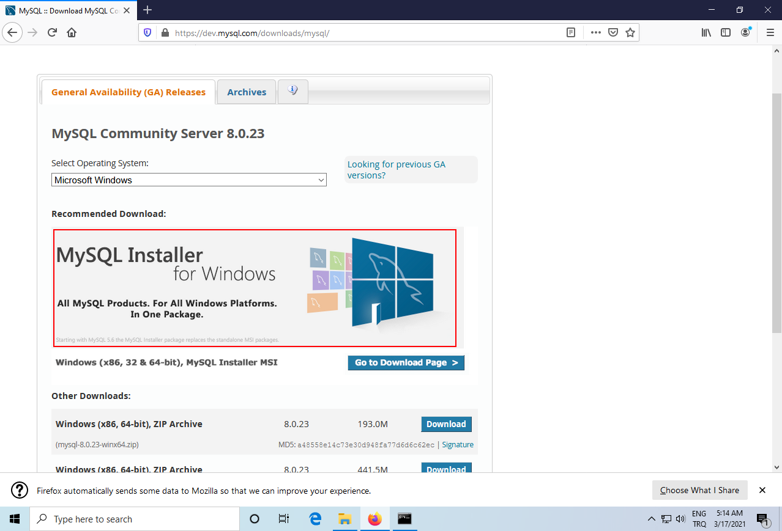
Installing MySQL on Windows
Use MySQL Installer for Windows

Slide 6
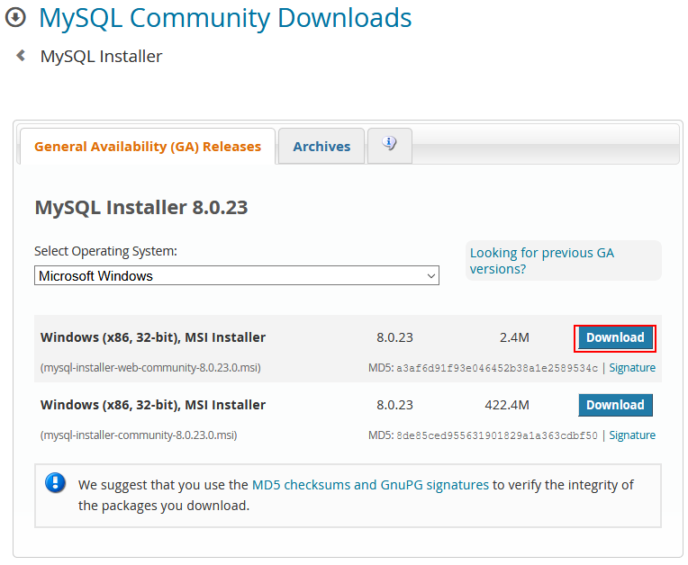
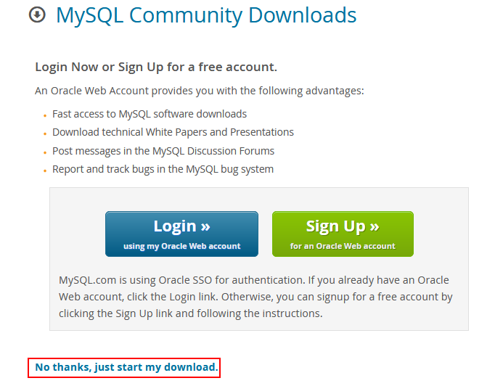
Installing MySQL on Windows

Slide 7
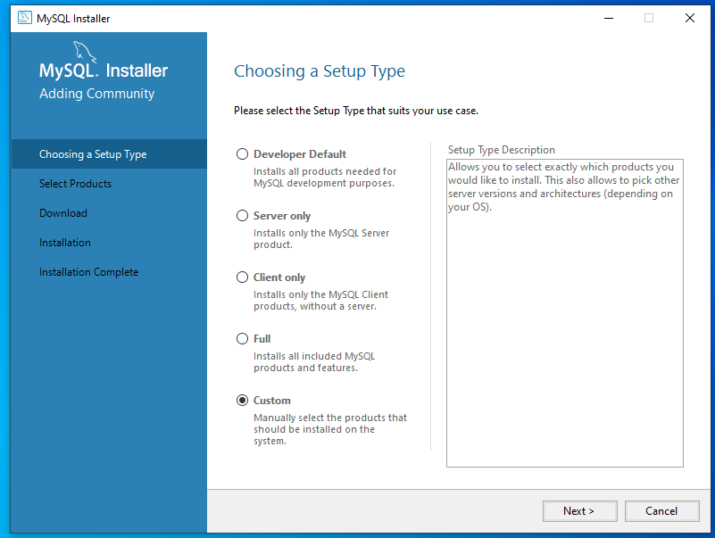
Installing MySQL on Windows
We need MySQL Server + MySQL Workbench
You can always install more things later if you need to
You can pick the Custom option now

Slide 8
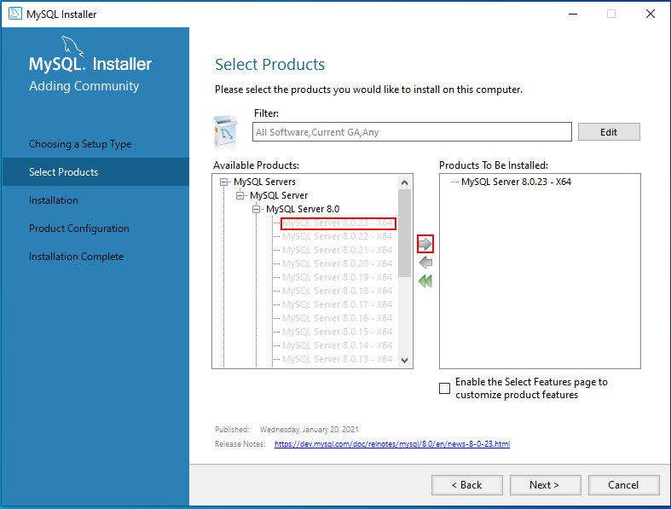
Installing MySQL on Windows
Pick the most recent MySQL Server version

Slide 9
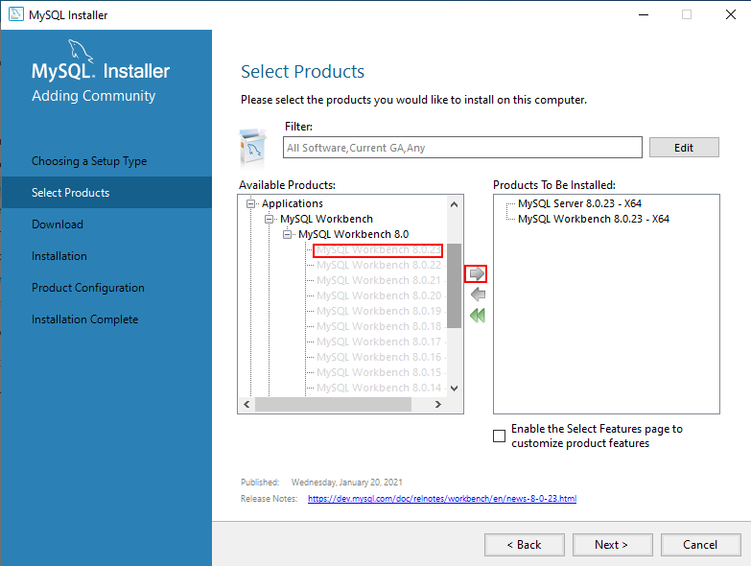
Installing MySQL on Windows
Pick the most recent MySQL Server version
Pick the most recent MySQL Workbench version under Applications

Slide 10
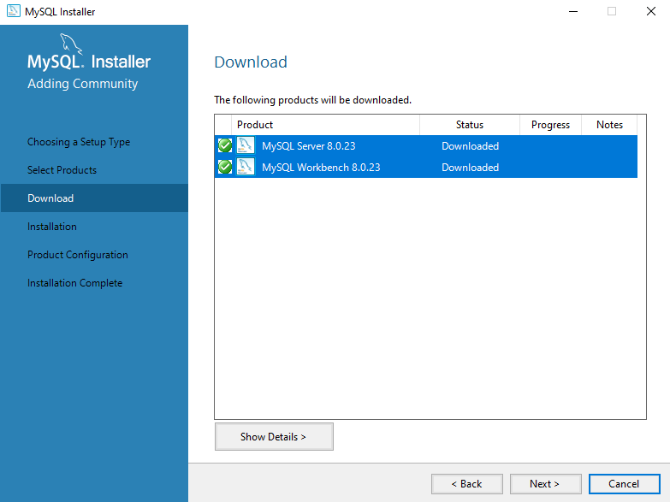
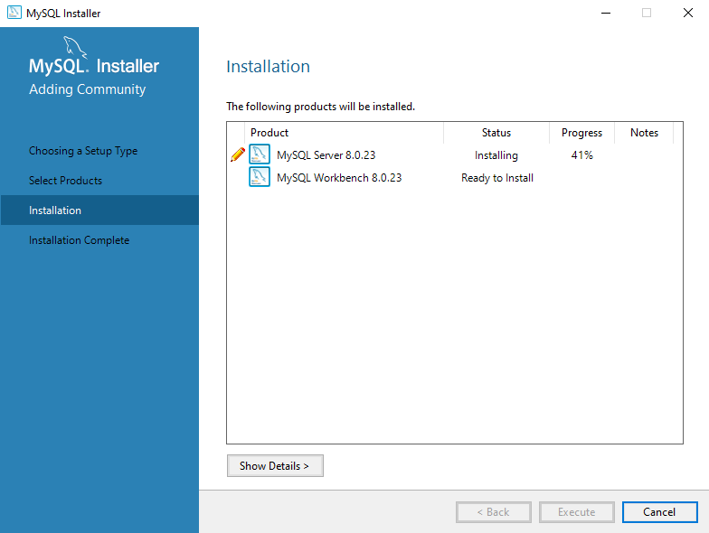
Installing MySQL on Windows
Download and install

Slide 11
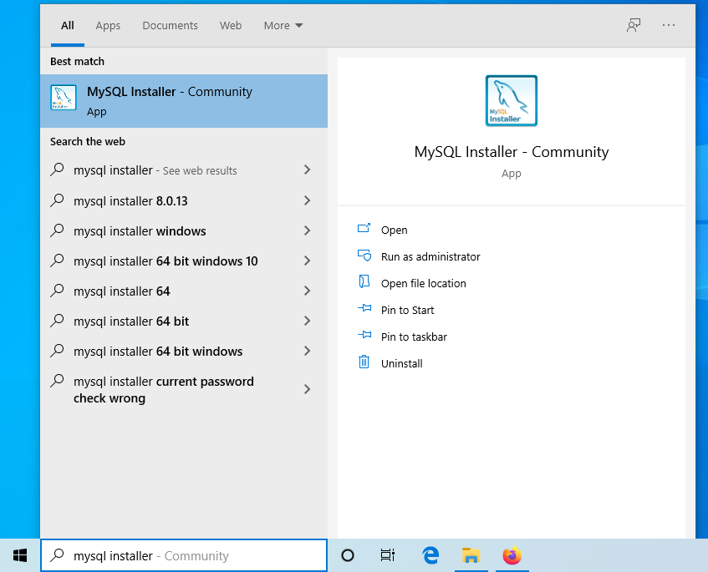
Installing MySQL on Windows
If the configuration screen comes up after installation, configure the root password there
Otherwise, run MySQL Installer again

Slide 12
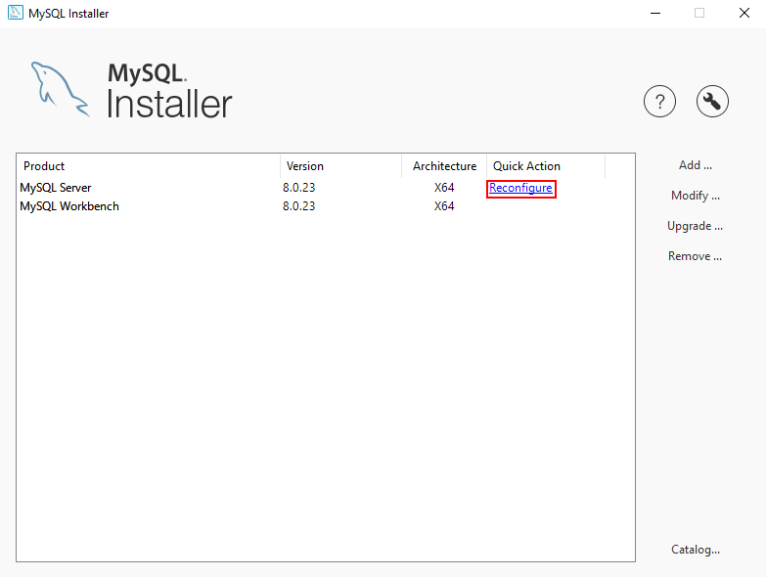
Installing MySQL on Windows
Click Reconfigure next to MySQL Server

Slide 13
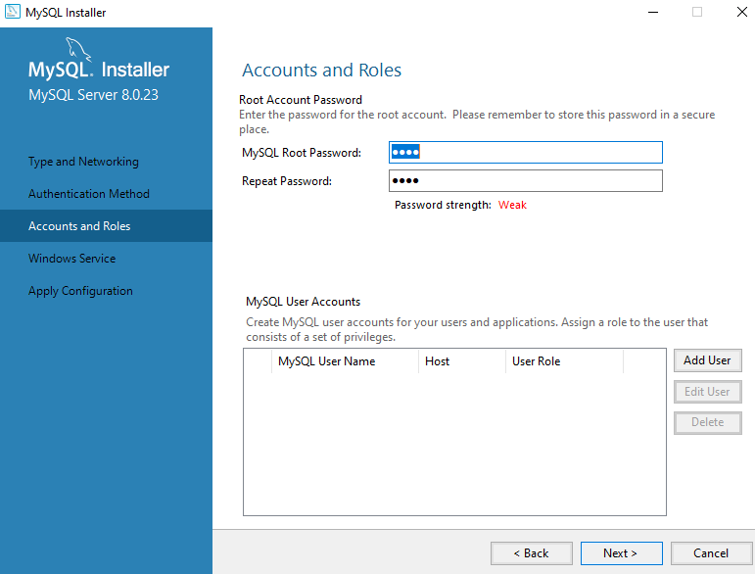
Installing MySQL on Windows
Click Reconfigure next to MySQL Server
Follow the instructions to set a root password
You do not need to create another user for now

Slide 14
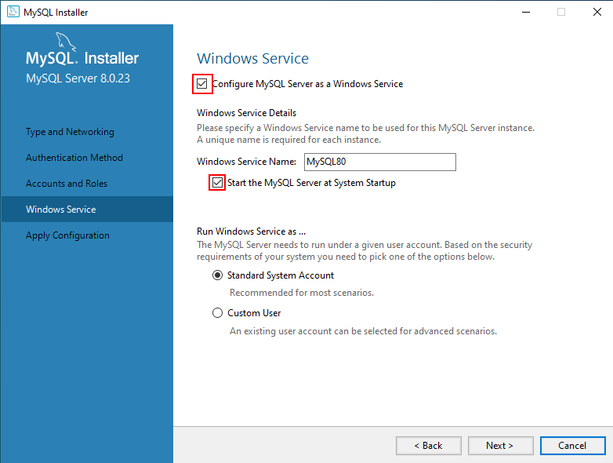
Installing MySQL on Windows
It is recommended to check the two boxes, otherwise you will have to start MySQL Server yourself

Slide 15
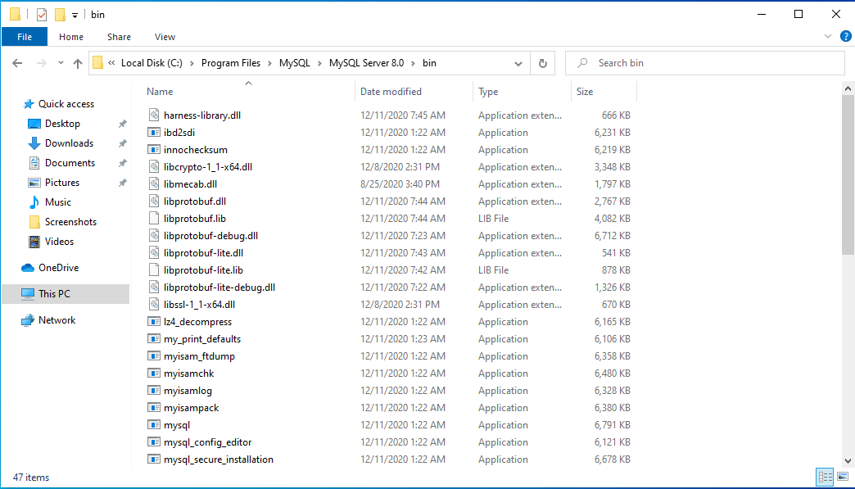
Installing MySQL on Windows
Test your installation:
Go to your MySQL Server bin directory

Slide 16
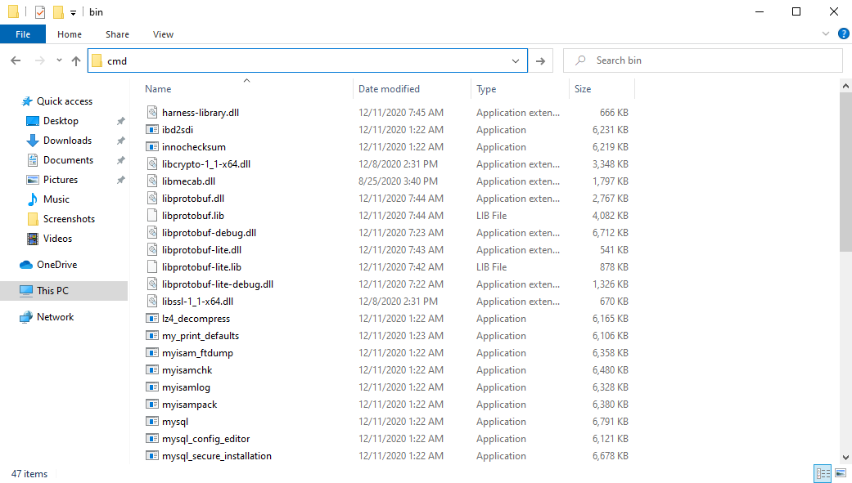
Installing MySQL on Windows
Test your installation:
Go to your MySQL Server bin directory
Type cmd in the address bar to open a command prompt in this folder

Slide 17
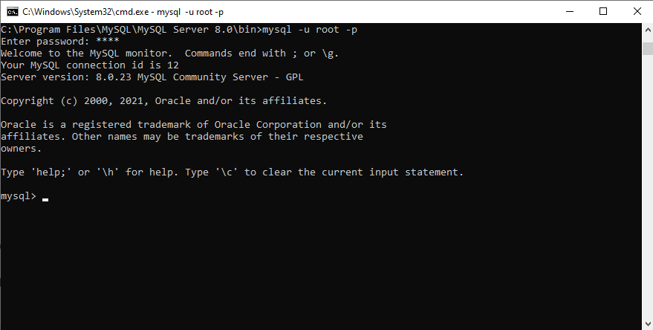
Installing MySQL on Windows
Test your installation:
Go to your MySQL Server bin directory
Type cmd in the address bar to open a command prompt in this folder
Run “mysql -u root -p” and enter the password you had set
You should be connected now, with no error messages

Slide 18
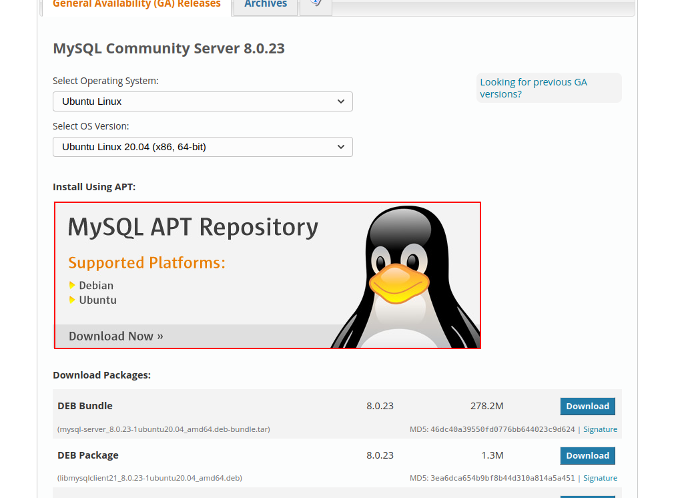
Installing MySQL on Ubuntu
Select your Ubuntu and click to install using APT

Slide 19
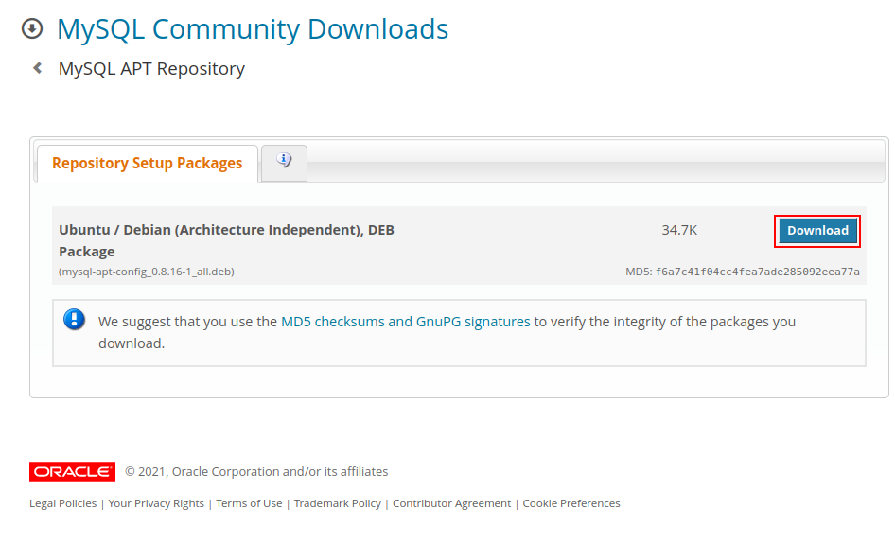
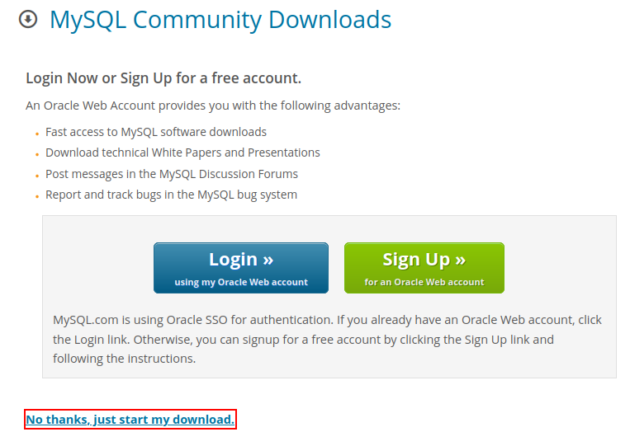
Installing MySQL on Ubuntu
Download the MySQL APT Repository package

Slide 20
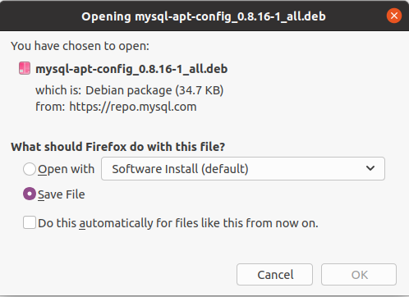
Installing MySQL on Ubuntu
Download the file and either execute it directly and install, or run the following command with the correct filename:
sudo dpkg -i mysql-apt-config_w.x.y-z_all.deb

Slide 21
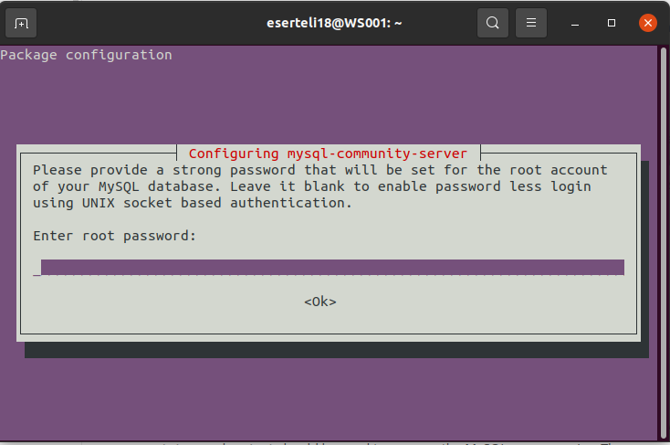
Installing MySQL on Ubuntu
Open a terminal and run
sudo apt-get update
Then run the following to install the MySQL Server
sudo apt-get install mysql-server
After the installation, you should get a configure prompt. Set a root password and continue.
Install MySQL Workbench as well:
sudo apt-get install mysql-workbench-community

Slide 22
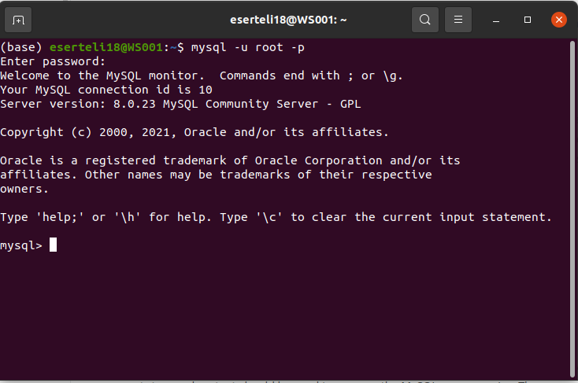
Installing MySQL on Ubuntu
Test your installation by running the following and entering the password you just set:
mysql -u root -p
You should be connected now, with no error messages

Slide 23
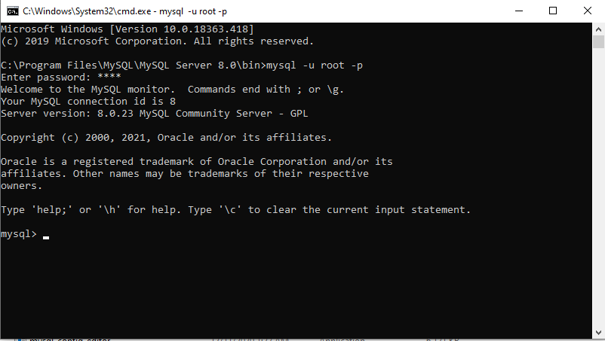
Accessing MySQL through the terminal client
The executable file called mysql is the terminal client and it comes with installing the server
Make sure that the executable directory is in system path or open a terminal in its directory directly
Running the following command will attempt to connect to the server with the user name user and ask you for the password in the next step
mysql -u user -p
You can use the root user and password that you set after installing

Slide 24
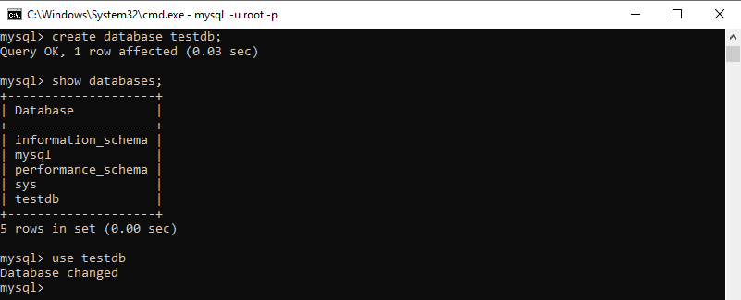
Creating and Selecting Databases
Create a database: CREATE DATABASE db_name;
Show the list of databases: SHOW DATABASES;
Select a database to use: USE db_name

Slide 25
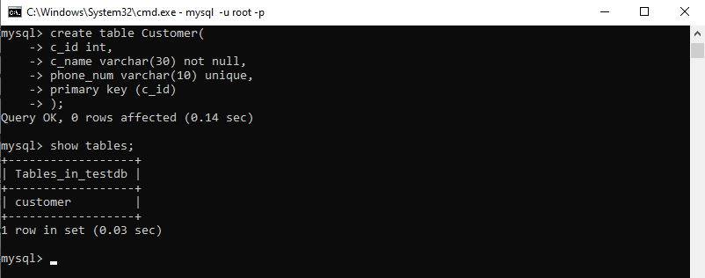
Creating Tables
CREATE TABLE table_name (
col1 type1 [NOT NULL] [UNIQUE]
col2 type2 …
PRIMARY KEY (...),
FOREIGN KEY (referencing_col, ...)
REFERENCES referenced_table (referenced_col, ...)
[ON UPDATE] [CASCADE/RESTRICT/SET NULL/...] [ON DELETE] [...],
…
);

Slide 26
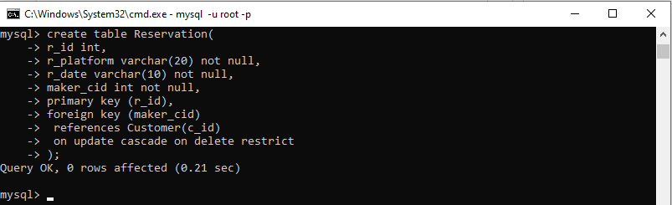
Creating Tables
CREATE TABLE table_name (
col1 type1 [NOT NULL] [UNIQUE]
col2 type2 …
PRIMARY KEY (...),
FOREIGN KEY (referencing_col, ...)
REFERENCES referenced_table (referenced_col, ...)
[ON UPDATE] [CASCADE/RESTRICT/SET NULL/...] [ON DELETE] [...],
…
);

Slide 27
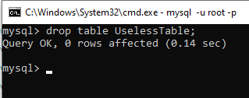
Dropping Tables
Drop (delete) a table: DROP TABLE table_name;
Be careful not to delete something important!

Slide 28
Data Types in MySQL
Basic data types in MySQL:
INT (TINYINT, SMALLINT, MEDIUMINT, BIGINT) | Exact integer data type with different storage sizes
FLOAT, DOUBLE | Approximate real number with different precisions
CHAR(size) | Fixed length string. Size can be from 0 to 255
VARCHAR(size) | Variable length string. Size can be from 0 to 65535
DATE | Date (year, month and day) data type
DATETIME | Date and time (hour, minute, second) data type
For more, check the documentation: https://dev.mysql.com/doc/refman/8.0/en/data-types.html

Slide 29
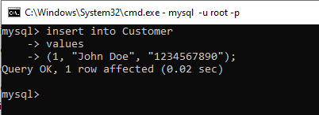
Inserting Tuples
INSERT INTO table_name [( field1, field2,...fieldN )]
VALUES ( value1, value2,...valueN );
You do not need to specify the fields if you are giving a value to all fields, in the correct order

Slide 30
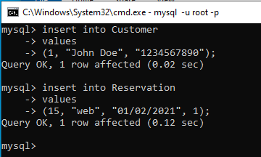
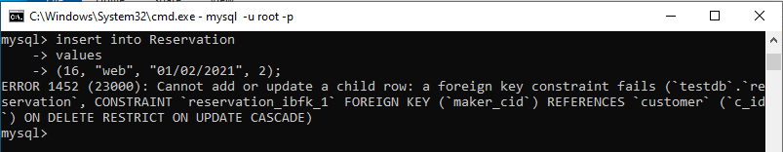
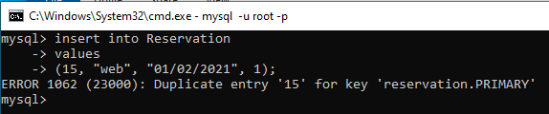
Inserting Tuples
INSERT INTO table_name [( field1, field2,...fieldN )]
VALUES
( value1, value2,...valueN );
You do not need to specify the fields if you are giving a value to all fields, in the correct order

Slide 31
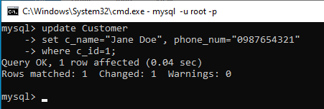
Updating Tuples
UPDATE table_name
SET col1 = val1, col2 = val2, ...
WHERE condition;
If you do not put a WHERE condition, every record will be updated

Slide 32
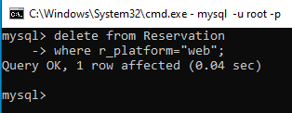
Deleting Tuples
DELETE FROM table_name WHERE condition;
If you do not put a WHERE condition, every record will be deleted

Slide 33
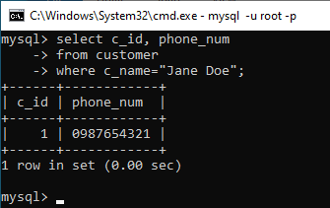
Select Queries
SELECT col1, col2, ...
FROM table_name
WHERE condition;
Instead of specifying the columns, we can put * to get all the columns
If you do not put a where condition, all records will be brought

Slide 34
Loading Data from Files
LOAD DATA [LOCAL] INFILE file_path
INTO TABLE table_name
You first need to set permissions to make this work:
Run SET GLOBAL local_infile=1; in the client (enables it in server)
Exit client (run exit) and start it again with the following:
mysql --local-infile=1 -u root -p
Use the local argument when loading
Use forward slashes in the file path even if you are on Windows

Slide 35
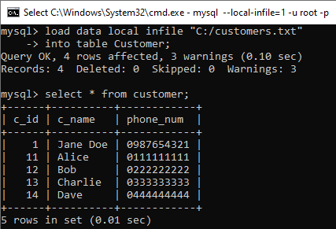
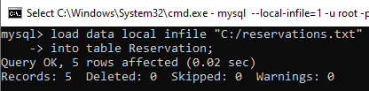
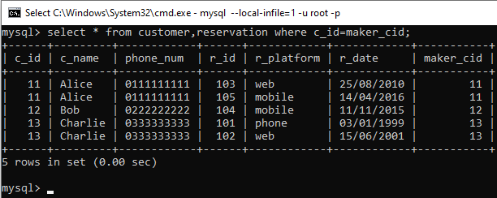
Loading Data from Files
LOAD DATA [LOCAL] INFILE file_path
INTO TABLE table_name

Slide 36
Exporting and Importing Databases
We can export a database using the mysqldump tool found in the same directory as mysql
mysqldump -u user_name -p db_name > path/to/file_name.sql
We can then import it as follows:
mysql -u user_name -p db_name < path/to/file_name.sql

Slide 37
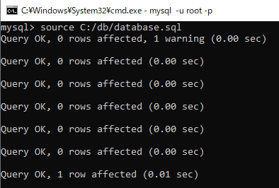
Exporting and Importing Databases
We can also import it within the mysql client, using the SOURCE command:
SOURCE path/to/file_name.sql

Slide 38
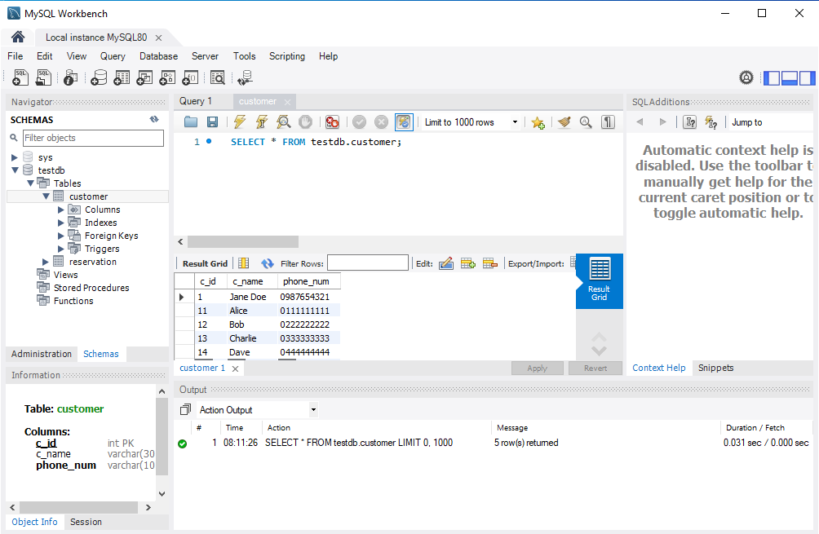
MySQL Workbench
A powerful GUI program for interacting with the MySQL server

Slide 39
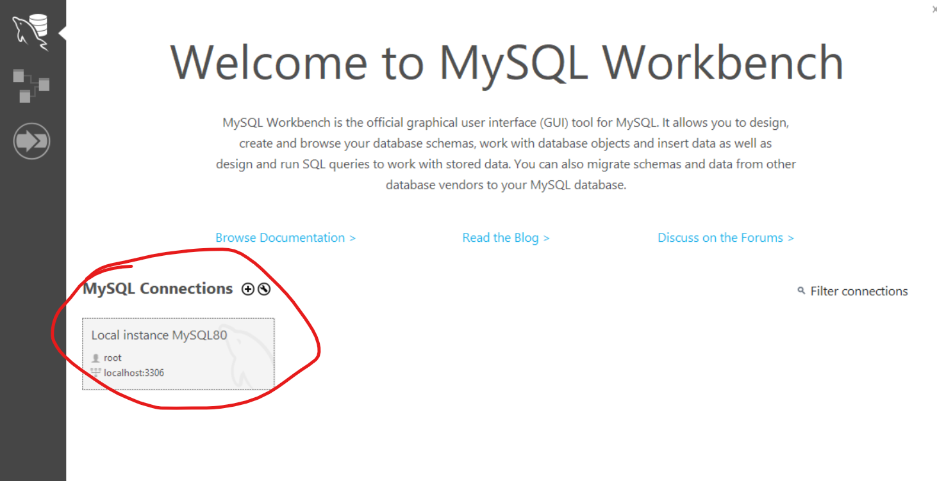
Connecting Database to Workbench
Select the db connection from “MySQL Connections”

Slide 40
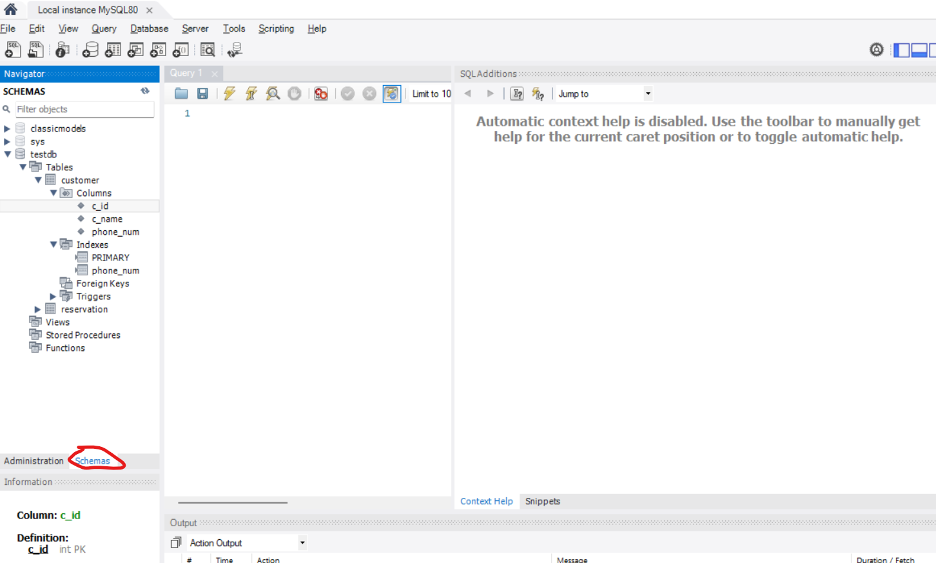
MySQL Workbench
Schemas tab provides information about connected databases.

Slide 41
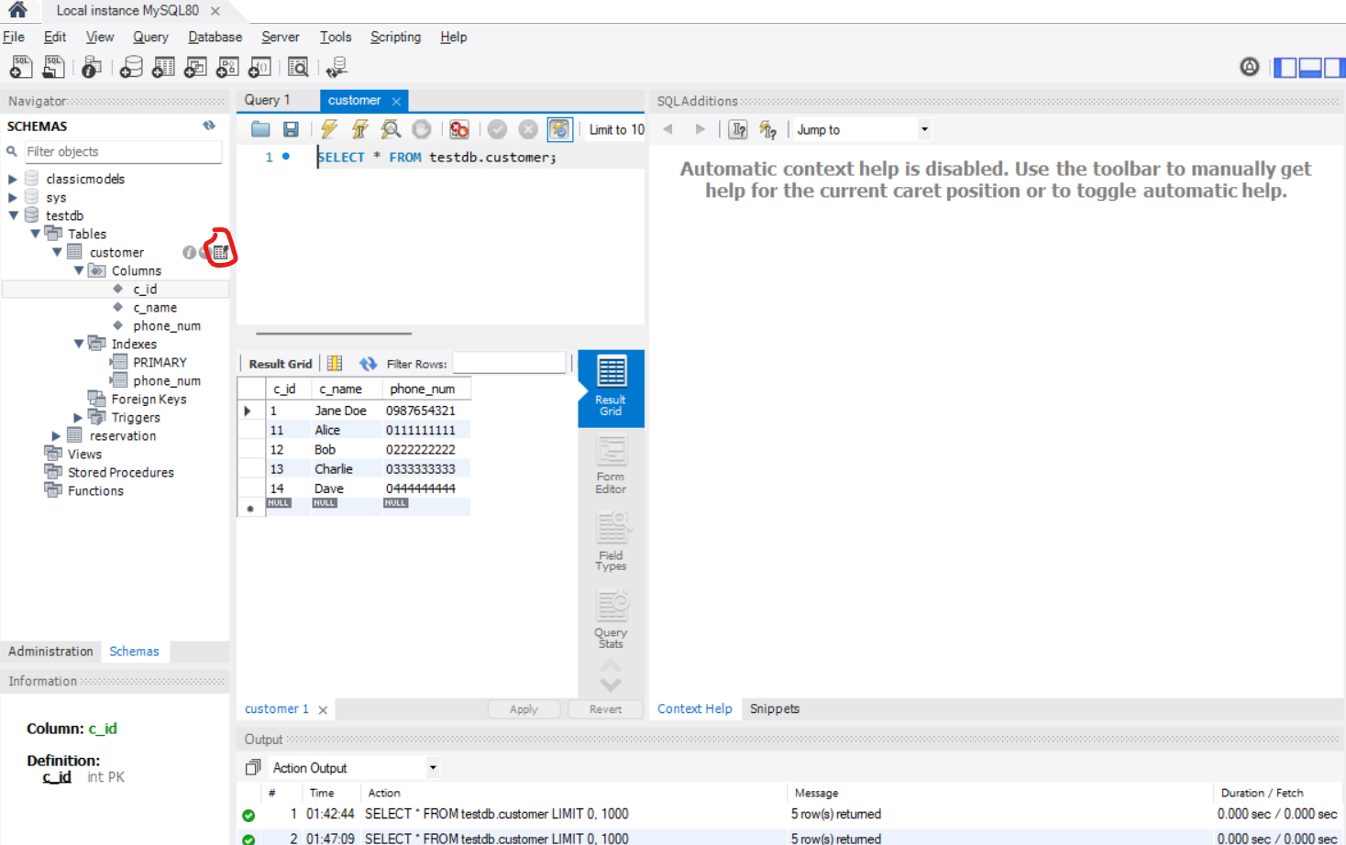
Examining Tables in Workbench
Display a particular table in the db.

Slide 42
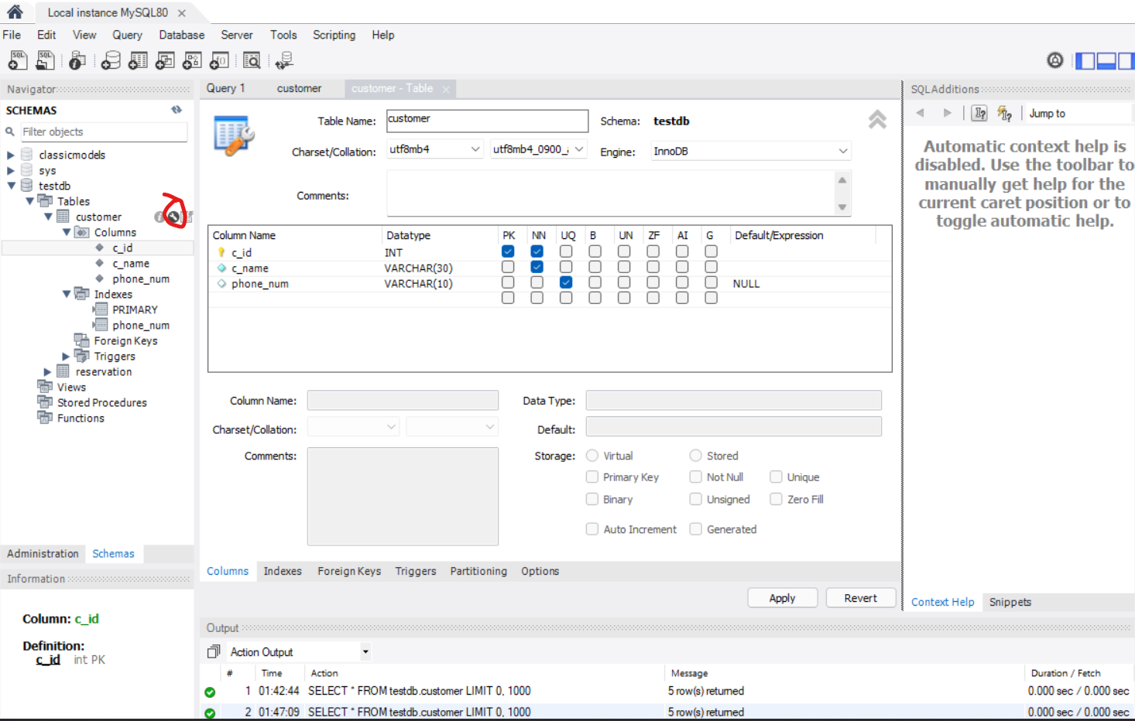
Examining Tables in Workbench
Modify a table

Slide 43
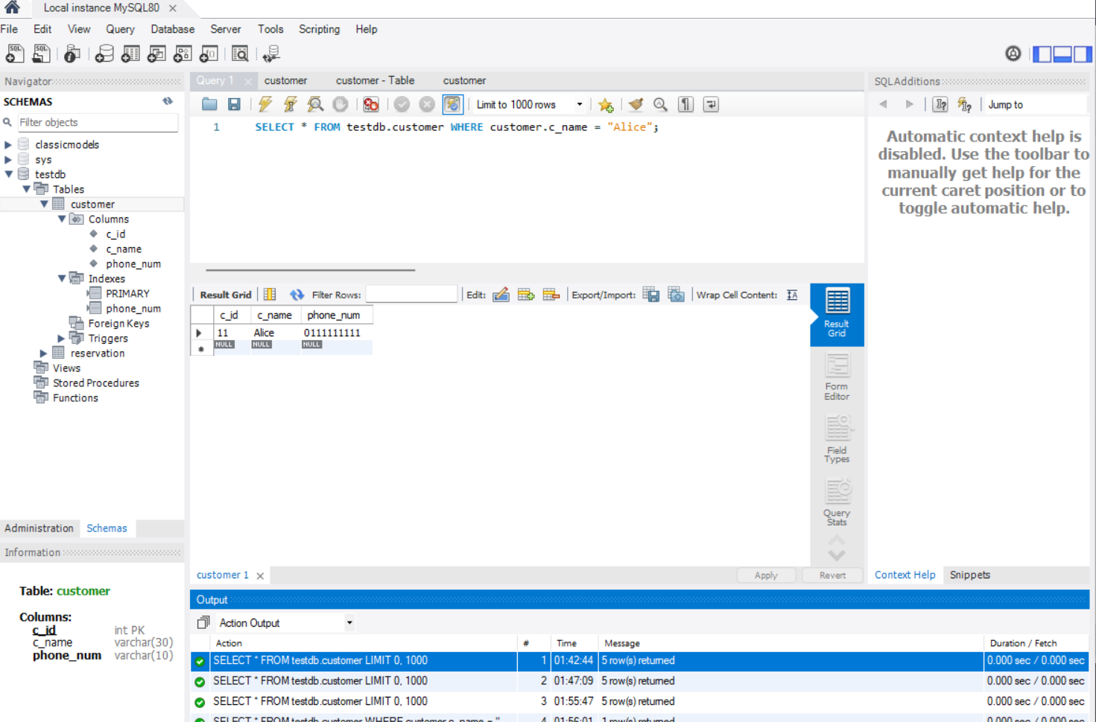
SQL Queries in Workbench
Write and execute queries, save them as sql files.

